Slide 1
Rockbuster Stealth - Analysis Results
Benjamin Arrants

Slide 2
Objective
Context
With competition from streaming services such as Netflix and Amazon Prime, Rockbuster Stealth is planning to use its existing movie licenses to launch an online video rental service to stay competitive.
To answer key business questions to help prepare a strategy for the new online video service launch

Slide 3





Data Rundown
1000
599
5 Days
Movies
Customers
Avg rental time
(no outliers)
PG-13
$61,312.04
Most common
Total revenue

Slide 4
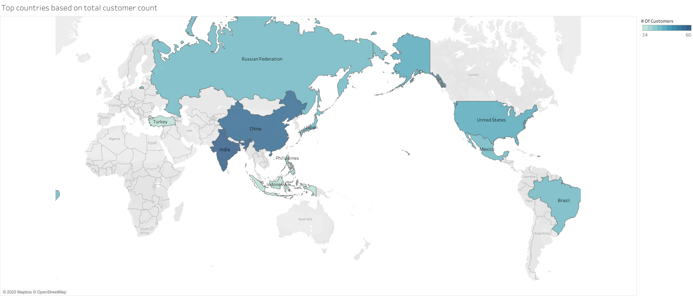
Which countries are Rockbuster customers based in?
Top 10 countries are primarily around the Pacific Ocean or in areas of Asia
Out of 108 countries, 40 of them have only 1 customer

Slide 5
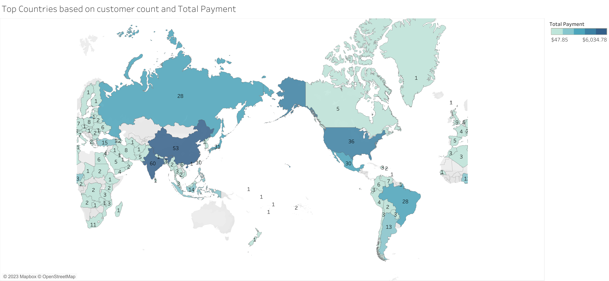
The map shows all countries with customers, the numbers displayed are their customer count, and the blue color is shaded darker as revenue increases.

Slide 6

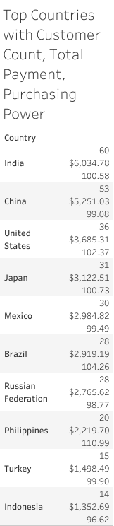

The Meaning?
Purchasing Power is how much payment was made per customer. A higher number means that country made more revenue per capita than another country.
There is a high correlation (99%) between Customer Count and Total Payment. Rockbuster benefits from increasing customer count in any country.
Purchasing Power highlights countries that should receive the most focus.
The Philippines is the country in the Top 10 with the highest Purchasing Power. If customer count increases, then the profit margin could be larger than other countries because of this.

Slide 7
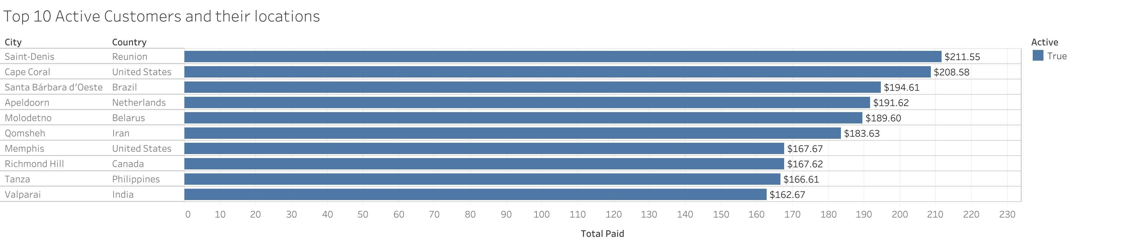
Where are customers with a high lifetime value based?
Average Total Payments by all customers amounts to $102
5 of the top 10 customers are based in top revenue countries (U.S., Brazil, India, Philippines)

Slide 8
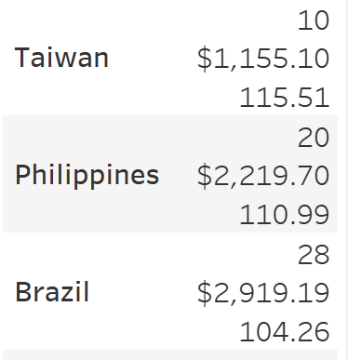
The Meaning?
Reunion only has the 1 customer who paid $211.55 total. Because of this, it has the highest Purchasing Power of any country.
Of all countries with customer count in the double digits, the 3 countries with the highest Purchasing Power are Taiwan, Philippines, and Brazil.
These countries have high lifetime value customers and are positioned well for additional growth.

Slide 9
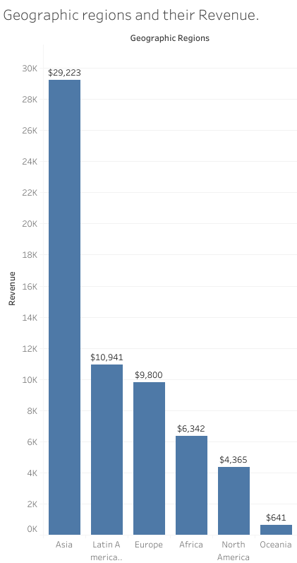
Do sales figures vary between geographic regions?
Yes! Asia is the top market for Rockbuster.
India by itself, accounts for nearly 10% of all total revenue
China is the second highest in total revenue.
Taiwan and Philippines have the highest Purchasing Power within the region.
The United States makes up over 80% of the North American revenue.
Rockbuster does not have many customers in the Oceania region, only 7 in fact, which is why the number is so low.

Slide 10
The Meaning?
Rockbuster’s key market is Asia. Nearly 47% of total revenue is from the Asia region.
Increasing growth in this market can be easier than in other regions because Rockbuster’s customer base is mainly in this region. Nearly 47% of all customers are in Asia.
Latin America is an important market because of the emerging country of Brazil, with relatively high customer count and high Purchasing Power.
If Rockbuster wants to penetrate more into the market of Oceania, the customer count needs to increase.

Slide 11
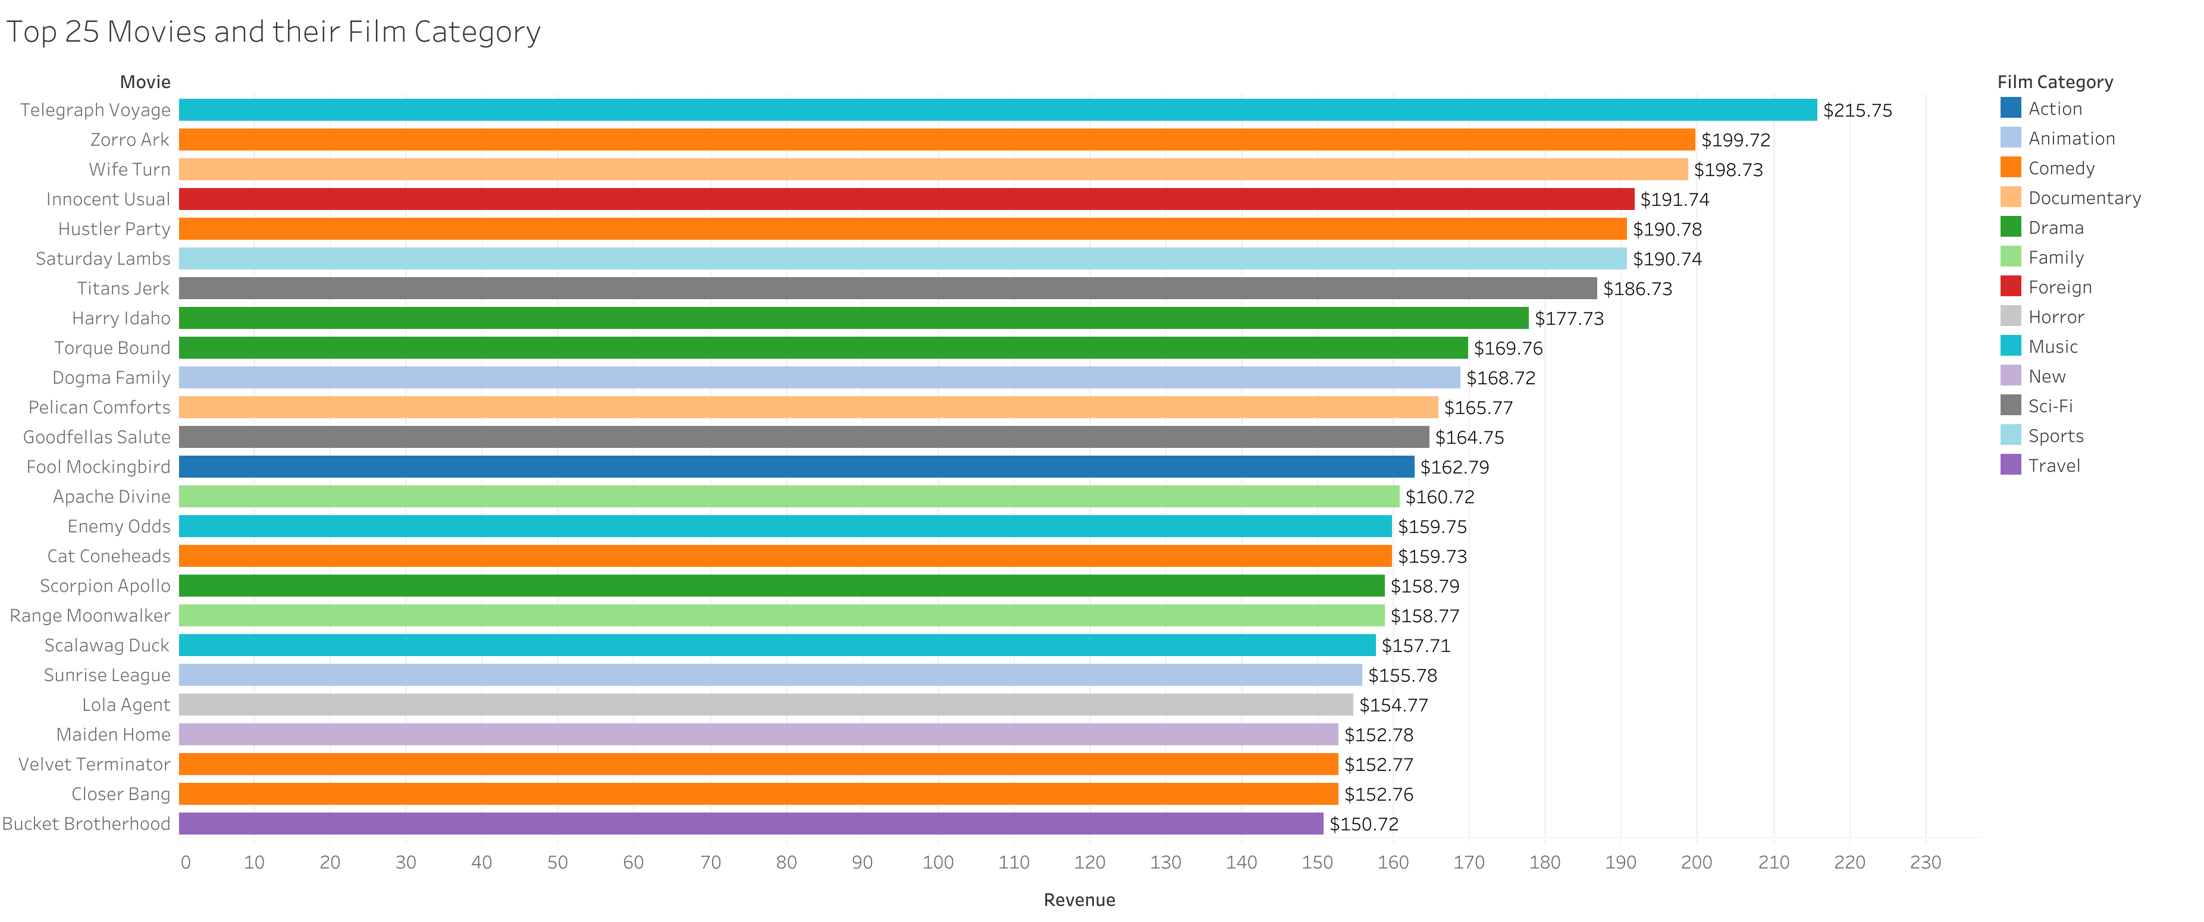
Which movies contributed the most/least to revenue gain?
Telegraph Voyage was the most profitable movie. A Music film
20% of the top 25 movies are Comedy

Slide 12
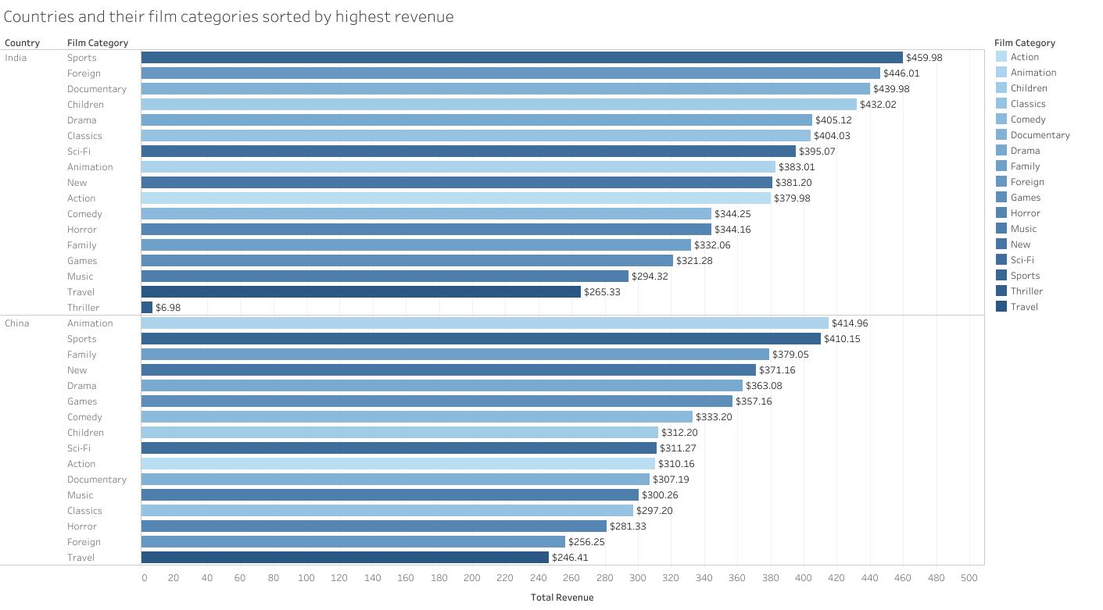
Animation is the leading film category in China, but middle of the pack in India. Sports is a top category in both.

Slide 13
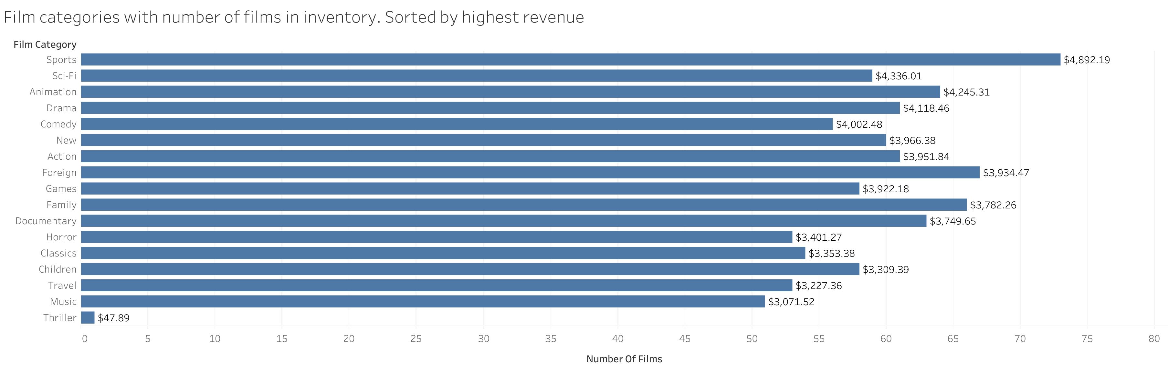
Sports is the top film category according to revenue and number of films in inventory
Sci-Fi, is the second most profitable genre, yet has much fewer movies.
Comedy, a category with 5 movies in the top 25 most profitable, has the 6th smallest inventory.

Slide 14
The meaning?
Sci-Fi made 88% of the profit of Sports with 20% less inventory.
If Sci-Fi has higher inventory, profit increases. If all else remains the same, and Sci-Fi has the same inventory size as Sports, it could potentially make 8% more revenue.
Sci-Fi and Comedy made more revenue per film than other genres
Sci-Fi is at $73 a film and Comedy at $71. Games was the third highest at $67.62
Even though the most profitable film was a Music genre movie, Music is not worth expanding as it is overall not profitable as a genre.
Foreign and Family film categories have many films in inventory but don’t contribute comparatively to revenue as other genres

Slide 15
Recommendations
Recommend targeted marketing in Philippines and Taiwan to take advantage of their large Purchasing Power. Target customer base increase of 50% for both.
Philippines, from 20 customers to 30
Taiwan, from 10 customers to 15
Increase marketing of Animation films, since the genre is the most popular category in both countries.
Increase marketing of Sports films in all regions to maximize number of customers on online platform.
Expand library of genres to maximize revenue.
Increase of Sci-Fi by 15% - from 59 to 68
Increase inventory of Comedy by 15% - from 56 to 67
Cancel licenses of genres to decrease costs
Decrease inventory of Foreign by 10% - from 67 to 61
Decrease inventory of Family by 10% - from 66 to 60
Cancel license for the 1 Thriller film in inventory. Not profitable and is probably costing money.

Slide 16
Thank you!
Visuals can be found on Tableau Public here

